Slide 1
NLP Chatbot (Question-Answering)
Using Transformer
Prepared By: Anika Tasnim
Course: ECE 7500
Notes:
Good Afternoon Everyone, My name is Anika and today I’ll share with you my project which is to build a medical question-answering chatbot using NLP transformers. This project is my first step in this field of NLP and I’ll go over the steps I took to build this chatbot and the potential I see in this technology in today’s presentation.

Slide 2
Agenda
Introduction to ChatBot
Dataset
Transfer Model Selection
Overview of Approach
Extractive vs. Generative ChatBot
Reason to select BERT Transfer model
Technical Challenges & Solutions
Goals and Expected Outcome
Future Enhancement
Conclusion
Notes:
This is the agenda that I’ll be discussing for today’s presentation. First I’ll start with the introduction to chatbot and the type of chatbot I’ve decided to build. Next I’ll go over the datasets I have used and the transfer models I have chosen to build this chatbot. Next I’ll go over the Overview of approach, the method or the design of my project. There are multiple options to choose from to build this type of chatbot and I‘ll go over them and will discuss why I chose my method. I will explain the Technical Challenges and solution, the Goal for this project, the result I have achieved and possible future enhancement and finally conclusion.

Slide 3
Introduction to Chatbot:
Project Focus:
Exploring the application of NLP and transformer models in developing a question-answering chatbot tailored for the medical field.
The Role of Transformers in NLP:
Introduction to transformer models, which represent a significant leap in NLP capabilities.
Their ability to understand context and nuances in human language, making them ideal for complex tasks like question-answering.
Importance in Medical Applications:
Discussing the critical need for accurate, efficient, and responsive tools in medical diagnostics and patient interaction.
How AI and NLP can assist healthcare professionals by providing quick access to medical information and supporting patient queries.
Challenges and Innovations:
Addressing the unique challenges in interpreting medical language and terminologies.
The potential of transformer models like BioBERT in bridging the gap between AI and practical healthcare applications.
Notes:
So what is a chatbot? As we all know chatbot is a software application designed to simulate human-like conversation with users, either through text or voice interaction. They are programmed to understand, interpret and respond to user questions and queries. There are rule based chatbot and some advanced chatbot that can learn through user interactions. We can also divide the chatbot into 2 categories: extractive and generative. my main focus of this project was to develop an extractive question-answering chatbot tailored for the medical field. This type of chatbot will not generate new text but will get answer from its current knowledge base. To build this extractive chatbot, I have used transformers models, as we already know that the transformers have revolutionized the field of natural language processing for their unique architecture and for handling complex language tasks. So why transformers are special? it is because unlike the previous NLP models, transformers can process entire sequences of text at once, rather than one word at a time. This allows them to understand context and the relationship between words in a sentence. Transformers are also very effective at capturing long-range dependencies in text. They can understand the relationship between words that are far apart in a sentence or document, which was a challenge for earlier models like RNNs and LSTMs. Also Transformers are highly scalable and more importantly they are often pre-trained on large corpus, so we do not have to start from scratch. And we can fine-tune then for our specific tasks.
Also there are multiple benefits of using chatbots in any field basically. I was particularly interested to build a medical assistant chatbot which is mostly for general purpose because i thought it could be very beneficial application in this particular field. For example Chatbots can be accessible 24/7 if we can scale it properly, which can provide information to providers and patients anytime outside office hours, It can also handle large volume of queries that can reduce the wait times and can assist the healthcare professionals, it can also provide immediate response for basic queries and symptoms, and finally overall it just can be an educational tool.
There are also some challenges dealing with a special area where domain knowledge and accuracy of information is very important. So I have used a special transformer for this project that can bridge the gap between general knowledge and practical healthcare application.

Slide 4
Datasets:
Introduction to BioASQ:
BioASQ is a benchmark dataset specifically designed for biomedical natural language processing and information retrieval.
It consists of rich biomedical questions and answers, making it a valuable resource for training NLP models in the medical domain.
Dataset Composition:
The dataset includes a variety of question types (factoid, list, yes/no, summary) along with corresponding answers and relevant articles from biomedical literature.
Answers are derived from sources like PubMed articles, providing a real-world and up-to-date medical knowledge base.
Relevance to NLP and AI in Healthcare:
BioASQ is pivotal for developing AI systems capable of understanding and processing complex medical texts.
It helps in training models to accurately interpret medical queries and retrieve relevant information.
Use in Chatbot Development:
For the chatbot project, BioASQ provides a foundation for training the chatbot to comprehend and respond to specific medical questions.
It aids in enhancing the chatbot’s ability to deliver accurate, contextually relevant medical information.
Challenges and Opportunities:
Discuss the challenges of working with specialized medical content, such as technical language and the need for high accuracy.
Highlight the opportunity to contribute to advanced medical assistance through AI and NLP.
Notes:
In this slide I will discuss the dataset I have used for my project. So, the main dataset I used is called the BioASQ dataset, this is specifically designed for biomedical NLP task and information retrieval. I chose this dataset because this dataset structure is similar to the squad dataset that we use to train for question answering task. While the squad dataset is used for general purpose this BioASQ dataset is specifically tailored to the biomedical field. Also Like the SQUAD dataset its structure consists of a question-answer pairs. And most importantly its content is focused on biomedical topics, including diseases, treatments, biological processes, and medical research. This dataset includes a variety of question types like factoid, list, yes/no, summary along with their corresponding answers and relevant articles from biomedical literature. So to explain what a factoid type question is that it's basically refers to queries that seeks very particular or concise factual answers. This may be a specific detail like dates, names, or places. For example, a factoid question might be, "Who was the first person to walk on the Moon?" to which the factoid answer would be "Neil Armstrong."
The answers in this dataset are derived from sources like PubMed articles, which provides a real-world and up-to-date medical knowledge. And the dataset is gets updated every year.

Slide 5
BioASQ Dataset:
Datasets for Task A (Semantic Indexing)
These datasets are designed for the challenge of automatically assigning semantic labels or indexes to biomedical documents, such as journal articles. This task is essential for organizing and retrieving information in large biomedical databases.
Datasets for Task B (Biomedical Question Answering)
Task B focuses on developing systems capable of answering biomedical questions. The datasets include questions and corresponding answers, which can be factual, list-based, yes/no, or summary questions, along with relevant biomedical documents or articles.
Datasets for Task MESINESP
This task is specifically focused on semantic indexing but in the Spanish language. It involves the classification and indexing of Spanish biomedical literature.
Datasets for Task C
Task C datasets are typically used for more advanced biomedical question-answering challenges, which may include complex queries requiring detailed and nuanced responses.
Datasets for Task Synergy
These datasets are designed for challenges that combine different aspects of biomedical NLP, such as semantic indexing and question answering, to create more comprehensive and integrated systems.
Notes:
So to sum it up, this dataset is an invaluable resource for developing and testing NLP models that are intended to be used in medical and healthcare-related applications. this dataset is also publicly available. if you just google BioASQ dataset it'll take you to their official website, then you can create an account and access the dataset for free. So, The BioASQ website offers various datasets organized by different tasks as you can see in this slide, each task is tailored to specific aspects of biomedical natural language processing (NLP) and information retrieval. There are task A, B, C etc.
the first one is the Datasets for Task A (Semantic Indexing)
These datasets are designed for automatically assigning semantic labels or indexes to biomedical documents, such as journal articles. This task is essential for organizing and retrieving information in large biomedical databases.
Datasets for Task B (Biomedical Question Answering) which I used for my chatbot, includes questions and their corresponding answers, which can be factual, list-based, yes/no, or summary type, it also contains the relevant biomedical documents or articles.
Then the next task is specifically focused on semantic indexing but in the Spanish language.
Task C datasets are typically used for more advanced biomedical question-answering challenges, which may include complex queries requiring detailed and nuanced responses.
Datasets for Task Synergy
These datasets are designed for challenges that combine semantic indexing and question answering, to create more comprehensive and integrated systems.

Slide 6
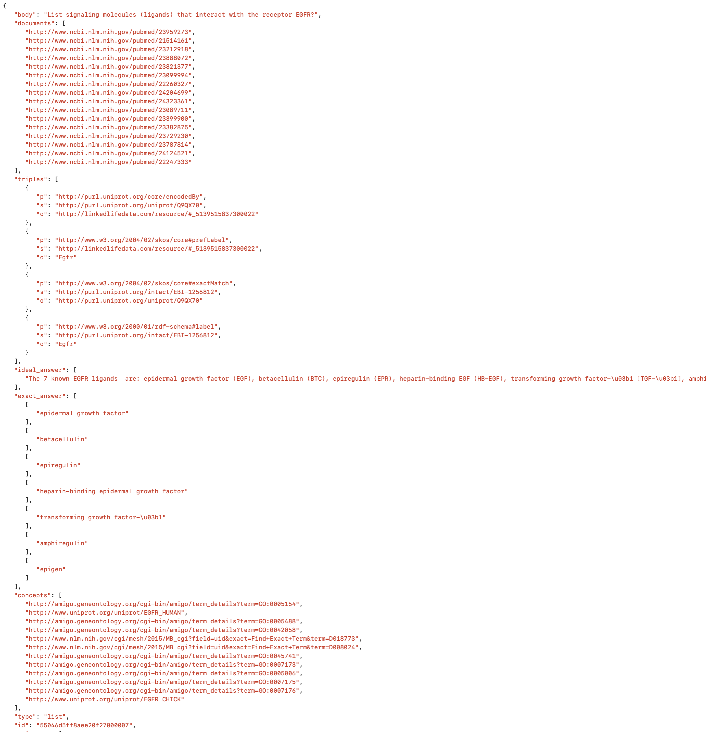
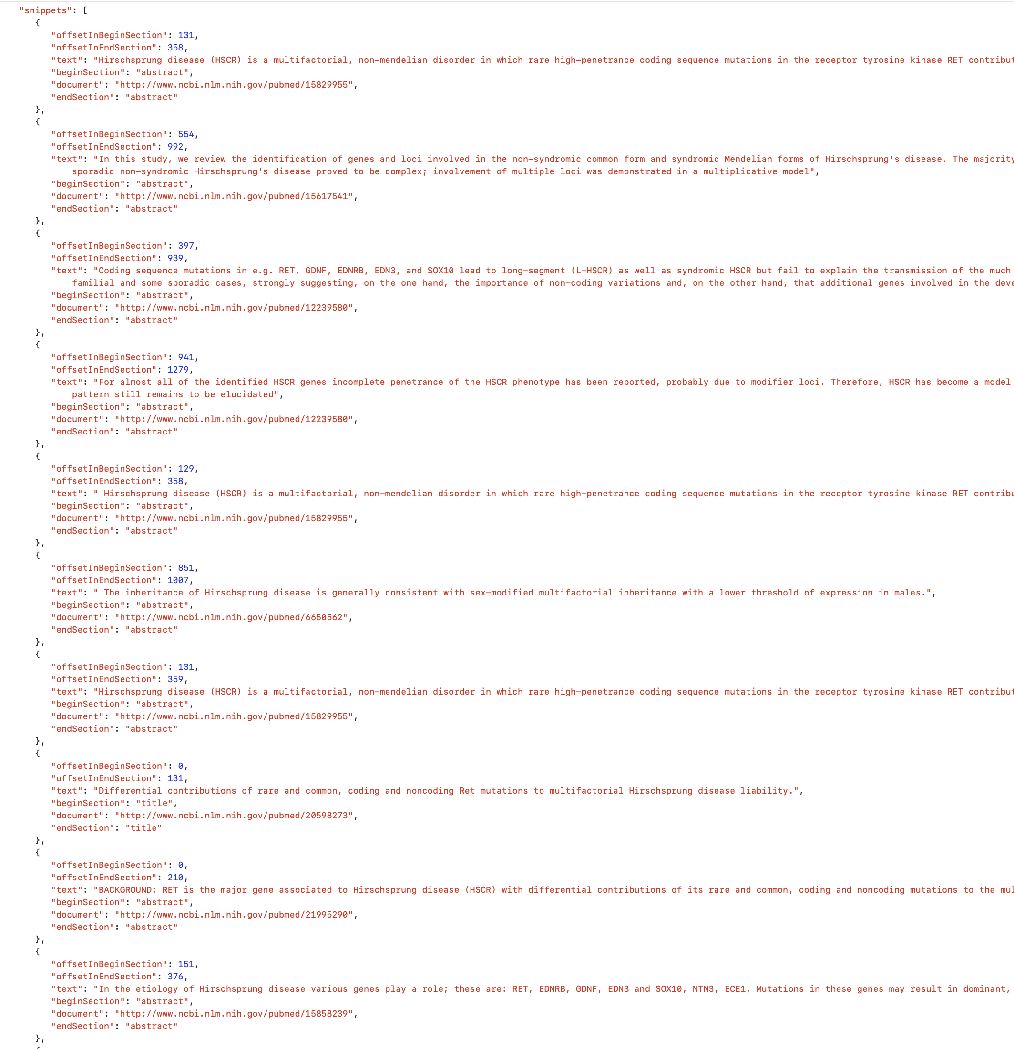
Notes:
I tried a take a picture of the actual dataset. so the dataset is basically a list of dictionaries, where each dictionary in the list is basically the question-answer pair with their relevant information. And in this slide, I tried to fit in just one dictionary that is the question-answer pair. But the actual dataset is pretty huge, to give you an idea the actual question is under the key ‘body’ and there are ‘ideal answer’ and ‘exact answer’. The context part that we will be needing for training is under the key ‘snippet’ on the right side which is also a list that contains all the relevant source information, the ‘text’ part is basically the context information.

Slide 7
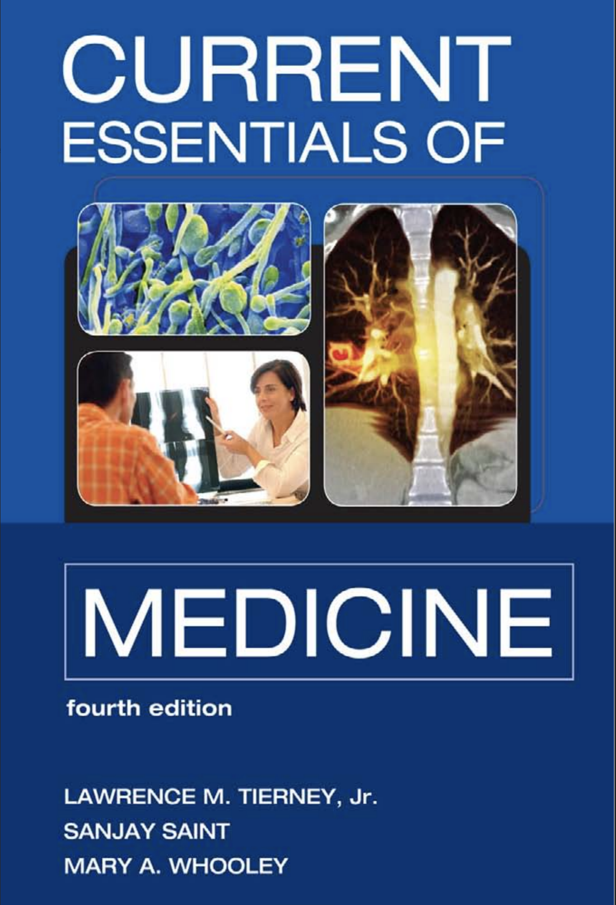
Domain Specific PDF Datasets:
Notes:
To prepare this kind of dataset for training can be very time consuming if they are not publicly available. So I wanted to see if I can do something with regular text type information without any formatting, So I wanted to implement PDF type documents related to medical field, as most up-to date-documents like research paper and other information are generally found in the PDF format. For my project I have a used a pdf file called current essentials of medicine which is also free to download from google. And this handbook has over 600 pages that offers "nutshell" information on the diagnosis and treatment of more than 500 medical disorders seen in both primary care and hospital settings.

Slide 8
Transfer Model Selection
Selecting the Right Transformer Model:
Importance of choosing a transformer model that aligns well with the complexities of medical data.
Criteria include language understanding depth, ability to process technical terms, and dataset compatibility.
Why BioBERT Stands Out:
BioBERT (Biomedical Bidirectional Encoder Representations from Transformers) is specifically pre-trained on large-scale biomedical corpora.
It extends the original BERT architecture by continuing the pre-training on biomedical domain texts, making it highly effective for medical NLP tasks.
BioBERT and BioASQ Synergy:
BioBERT's pre-training on biomedical literature, such as PubMed abstracts and PMC full-text articles, complements the nature of BioASQ.
This synergy enhances the model's ability to understand and accurately respond to BioASQ's biomedical questions and answers.
Performance Metrics:
BioBERT has demonstrated superior performance in various biomedical NLP tasks, including named entity recognition, relation extraction, and question answering.
Cite specific benchmarks or studies where BioBERT excelled in tasks relevant to the BioASQ dataset.
Implications for Chatbot Development:
Training the chatbot using BioBERT and the BioASQ dataset ensures high-quality, domain-specific responses.
The combination is ideal for developing a chatbot that can handle intricate medical inquiries reliably.
Notes:
Next is Transfer Model selection. It is very important to choose the right transformer model that can balance between the performance needs and available resources which is limited in most cases. The Transfer Model I chose for this project is the BERT Transformer model and its variants. As the goal of my project is to build an extractive question-answering chatbot, BERT can be considered the most suitable choices and it has several reasons.
first is understanding context from both sides, BERT uses bidirectional encoders to understand the context and depth of natural language. Consider BERT as a stack of transformers placed on top of each other- and each of these transformers help understand the text better so the more units you have the more it understands the language. Also, inside each transformer layer, there's something called an 'attention mechanism'. This helps BERT focus on important parts of a sentence and understand how words relate to each other within the sentence. Next is that it is pre-trained on a lot of data and it is relatively easier to fine-tune.
There are other transformer models that can be used to question-answering tasks but BERT is relatively smaller model. There are other transformer models that are more sophisticates like GPT and Roberta. Roberta is also a variant of BERT that was trained on more data with longer sequence and then GPT was developed by OpenAI for generative tasks. As I am building an extractive question-answering chatbot, where I have to extract specific answer from larger text BERT seemed like a better choice because of its ability to understand words in full context. It can understand the how the position of a word works because of it’s bidirectional method unlike some models that just consider text in one direction. Secondly as it is already pre-trained on a lot of data, so it comes with a lot of knowledge about language and how the words are typically used in a sentence. And when it's time to answer questions, BERT can use this knowledge to better understand and find answers. If we want to teach BERT more about a particular topic, like medicine or law, we can do so by fine-tuning, which makes BERT even better at answering questions related to these areas. Finally, it’s good at pulling out information. For example, Extractive question-answering is like a treasure hunt for specific words or phrases in a text that answer a question. BERT excels at this because it's good at pinpointing the exact part of the text where the answer lies, it is because of its deep understanding of language context.

Slide 9
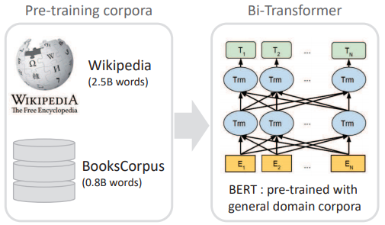
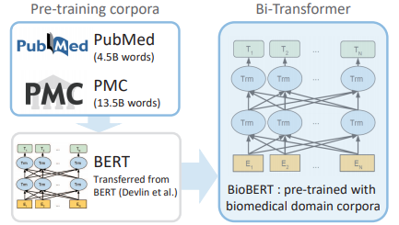
BERT VS. BioBERT Model
BERT | BIOBERT
Notes:
I have also used a variant of the BERT model called BioBERT which is on top of general data it is specifically pre-trained on large scale medical corpora. This is like an additional layer. This slide shows a comparison between BERT and BioBERT. One thing to note from this slide is that BioBERT is not necessarily "bigger" than BERT in terms of its architecture or the number of parameters. BioBERT is essentially a version of BERT that has been further trained (or fine-tuned) on biomedical text. The core architecture of BioBERT is the same as that of the original BERT model.
BioBERT converts words and sentences into numerical forms (vectors) that capture their meanings. These vectors then go through the transformers, which analyze and reanalyze the text, each time gaining a deeper understanding of the language and context. So, BioBERT is pre-trained on a large amount of text data (general English corpus plus biomedical texts), where it learns the basics of the english language and biomedical knowledge.
So BioBERT is pre-trained on biomedical literature, we will use this model to fine-tune it on the BioASQ dataset, which is specifically designed for biomedical question answering. This further enhances its performance in this particular domain. This is like when we trained the SQUAD dataset using the BERT model for question answering. When it's used for a specific task, it undergoes additional training or fine-tuning to tailor its understanding to that particular task.

Slide 10
Overview of Approach for Medical NLP Chatbot
Design of the Project
Utilizing BioBERT for Medical Context:
Training the BioBERT transformer model on the BioASQ dataset, known for its rich medical content.
Emphasis on the model’s ability to understand complex medical terminologies and context.
SQuAD for Semantic Understanding:
Further training with a general-purpose BERT model on the SQuAD dataset.
Aimed at enhancing the chatbot's capability in understanding and interpreting semantic meanings in user queries.
Domain-Specific Data Handling:
Converting domain-specific medical PDFs into text and chunking them for analysis.
Describing how the chatbot processes these chunks to locate relevant information in response to user queries.
Incorporating Wikipedia for Comprehensive Coverage:
Augmenting the chatbot’s knowledge base with Wikipedia data for queries beyond the BioASQ scope.
Strategy to ensure versatility and breadth in answering diverse medical questions.
Extractive vs. Generative Chatbot:
Choosing an extractive approach to ensure precise and contextually relevant answers.
Discussing the rationale behind this choice and its implications for chatbot performance.
Notes:
Next slide is the overview of approach, I will discuss how I designed the medical chatbot for my project. We have already worked with question-answering task in this class, where we basically ask the question while providing the related context at the same time after we do the fine-tuning with transformer model and the dataset. But for designing a chatbot I thought that is not convenient if I have to provide the context myself. So I wanted to implement in such a way that when the user asks a questions to the chatbot, it should be able to identify the keyword and find context related to that keyword from the dataset as well.
I’ll discuss it more in a minute. So at first, I have trained the BioBERT Transformer model on the BioASQ dataset. Even though I have used google colab GPU to train the model, it took hours to train one epoch.One reason is the the BERT model still has a lot of parameters to train and the BioASQ dataset also has a very complex structure to train. That’s why I used one dataset from BioASQ task B for this project for now. The purpose of this training was to train the BioBERT model to understand the complex medical terminologies and context in this particular domain.
As I did not get to use the full BioASQ dataset, I have used the current essential of medicine pdf file for training as well, this is just to give the chat bot a bit more knowledge. To handle the PDF dataset, I thought of implementing regular BERT model on the SQUAD dataset for semantic understanding in question-answering tasks. This also gave me a chance to compare the two models to see if one has any advantage over the other.
To train BERT models for question-answering tasks, the dataset has to be in a specific format. But from the beginning my main goal was to incorporate large documents or websites to this chatbot, where it can gather its contextual information from. For example if I have multiple documents like PDFs related to a specific domain, then the chatbot should be able to handle it as well. Understanding the semantic meaning from these documents is the main reason behind training the regular BERT model.
Because of limited resources I have only included one PDF document in my project, but we can definitely add as many pdfs as we want depending on our resources. So to process this kind of documents I have converted the PDFs into plain text and then converted the whole pdf text into smaller chunks.
Now going back to the point where I mentioned the chatbot should be able to retrieve necessary context related to the user queries. For this step I have assigned Id’s to each question-pair in the BioASQ dataset. So when an user asks a question, it’s going to recognize the ID based on the question embedding and grab the context using the ID. But for PDFs it is basically just raw text and their format is not like question-answer pair like in the bioasq dataset. So After converting the PDF into raw text I have divided it into chunks, so when the user asks a question, it’ll loop through the chunks and see if it can find any relevant chunks for context. The relevant chunk will be determined by keyword or phrases. So if something like this happen where there are multiple chunks related to the user query then the model will calculate the score for each question-chunk pair, and we will consider the chunk with the highest score.
Next I have also considered using Wikipedia for handling some user queries that might not be present in the PDFs or the BioASQ dataset. This is just to unsure the chatbot can handle diverse type of queries. So how this would work is when the user asks a question, the chatbot will request information for that user query and save it as a context. This context can be used to find answers using the BERT model. I have used Wikipedia for this project and although it is not a reliable source, the chatbot will be able to handle most queries and we can definitely implement this idea to access other reliable websites related to the query or any particular domain by making API calls or something similar. This is something that can be further enhanced in future.

Slide 11
Domain Specific Data Handling:
Processing Domain-Specific Documents:
Discuss the approach to handling and extracting information from medical PDF files, which are rich in domain-specific knowledge.
Emphasize the importance of specialized data handling for accuracy in medical contexts.
From PDFs to Processable Text:
Detail the method of converting PDF content into a text format suitable for NLP processing. This includes text extraction, cleaning, and standardization.
Mention the use of tools or libraries (e.g., PyPDF2, PDFMiner) for efficient text extraction from PDFs.
Chunking for Effective Analysis:
Explain how large documents are broken down (chunked) into smaller, manageable pieces to fit the input size limitations of transformer models.
Discuss how this chunking ensures comprehensive coverage of content without losing context.
Transformers’ Role in Understanding Complex Texts:
Highlight how transformer models like BioBERT are adept at understanding the intricacies and nuances of medical language in these documents.
Illustrate the capability of transformers to contextualize and interpret domain-specific terminologies.
Scaling to Multiple Documents:
Describe the model's scalability and flexibility in processing multiple documents, allowing for expansive knowledge coverage in the medical field.
Mention the potential for automated updates and inclusion of new research or medical findings through continuous processing of updated or new PDFs.
Notes:
This slide is just just more bit into detail on how I handled the Domain specific data, basically explains how to handle the PDF type data. We can easily convert the PDF content to text using the PyPDF2 library. And as I explained before we break the large text into chunks which will be used as contexts. The size of chunks can be adjusted. And, this is like a parameter that we can experiment with. And like I mentioned previously we can definitely add as many documents as we want if we have the resources and it is still the same method. Or maybe depending on the application we can structure the text in more organized way like a dictionary.

Slide 12
Utilizing SQUAD Dataset & BERT Model:
Introduction to SQuAD and BERT:
Briefly introduce the Stanford Question Answering Dataset (SQuAD) and the BERT (Bidirectional Encoder Representations from Transformers) model.
Explain how SQuAD, with its extensive range of questions and answers, serves as a robust training ground for NLP models.
BERT’s Adaptability to Diverse Contexts:
Highlight BERT’s design for understanding context and nuance in language, making it suitable for a variety of domains, including medical.
Discuss how pre-training on a diverse dataset like SQuAD broadens the model's capability to handle different types of text.
Enhancing Medical Data Comprehension:
Elaborate on the application of BERT, trained on SQuAD, in processing domain-specific medical datasets.
Describe how this training equips the model with a more generalized understanding of language, aiding in better interpretation of medical texts.
Integration with Domain-Specific Models:
Discuss the strategy of combining BERT’s broad linguistic understanding with the specialized knowledge from domain-specific models like BioBERT.
Illustrate how this integration results in a more versatile and competent chatbot capable of handling complex medical inquiries.
Practical Benefits in Medical NLP:
Emphasize the practical outcomes, such as improved accuracy in answering patient queries, and the ability to interpret a wider range of medical literature and documentation.
Highlight potential use cases in healthcare, such as aiding medical research, assisting practitioners, and enhancing patient engagement.
Notes:
I have also mentioned the intention of using a regular BERT model and utilizing the SQUAD dataset. As we already know it is very popular for question answering. And I wanted to use it basically for my PDF dataset, so that this can understand the semantic meaning when I present the context from the pdf file.
So when the bert model is traind on the squad dataset it’ll take use query and related context as input (which is basically the relevant chunk from the pdf) and determine the answer from the context. BioBERT works the same way. But I just wanted to see if the performance of the two-model given the same query and context differs. As expected the BioBERT gives more concrete and more specific answer while BERT model doesn’t always give the most specific result. It is mostly longer and sometimes the answers are not quite right.

Slide 13
Incorporating Wikipedia:
Fallback to Wikipedia for Unmatched Queries:
Explain the strategy of using Wikipedia as a secondary information source when the chatbot model does not find relevant context in its primary dataset.
Highlight Wikipedia's comprehensive coverage and its utility in providing general information on a wide range of topics.
Benefits of Wikipedia Integration:
Discuss how Wikipedia serves as an expansive knowledge base, enhancing the chatbot's ability to respond to diverse and unexpected queries.
Elaborate on Wikipedia's regularly updated content, ensuring that the chatbot can provide current and accurate information.
Alternative Reliable Sources:
Outline the potential of integrating other authoritative sources like WebMD, Mayo Clinic, or specialized medical databases for more domain-specific information.
Emphasize the importance of source credibility, especially in sensitive fields like healthcare.
Dynamic Information Retrieval:
Describe the process of dynamically querying these external sources in real-time to fetch relevant information.
Discuss the implementation of API requests or web scraping techniques, adhering to ethical and legal guidelines.
Expanding the Chatbot’s Capabilities:
Explain how supplementing the chatbot with external sources can significantly enhance its versatility and reliability.
Highlight the potential for customizable source selection based on the specific needs and focus areas of the chatbot’s application.
Notes:
I have also discussed the importance of incorporating Wikipedia. The idea was to give the chatbot a little more versatility so that it can answer random questions if it cannot find it in the datasets. And we could use an alternative platform to get more reliable result. The idea was to expand the chatbot’s capability to access external resources if it’s necessary.

Slide 14
Extractive vs. Generative Chatbots
Extractive Chatbots:
Define Extractive Chatbots: They respond by extracting information directly from a given text or dataset.
Mention your use of BERT for building an extractive chatbot, highlighting its ability to understand context and retrieve specific answers.
Generative Chatbots:
Define Generative Chatbots: They generate new responses from scratch, often using advanced language models.
Best Options for Generative Models:
GPT-3 (OpenAI): Known for its deep learning capabilities to generate human-like text.
T5 (Text-To-Text Transfer Transformer): Excels in translating text-based questions into appropriate responses.
Comparative Analysis:
Extractive Chatbots are precise and fact-oriented, ideal for queries needing specific information.
Generative Chatbots offer more flexible and conversational responses, making them suitable for diverse interactive experiences.
Other Robust Chatbot Building Methods:
Incorporating Reinforcement Learning for dynamic response optimization.
Using Hybrid Models that combine extractive precision with generative creativity.
Implementing Multi-Modal AI for understanding and responding to non-text inputs (images, voice).
Evolving Chatbot Technologies:
Future trends and advancements in AI that could revolutionize chatbot capabilities and applications.
Notes:
So there were two options to choose from to build this chatbot as I have discussed previously. I’ll go over the differences in detail: An extractive chatbot, like the one I’ve been working on, works by identifying and extracting the most relevant pieces of information from a given text source to answer user queries. this chatbot, for instance, searches through the BioASQ dataset and other integrated resources like PDF documents and Wikipedia to find precise answers. So it cannot answer if it is not in the context. The advantage of this approach is that it is able to provide accurate and specific information, directly sourced from existing content. Which is why I think this type of chatbot are more practical in medical field where providing correct and precise information is more critical
On the other hand, generative chatbots functions differently. It can be created using OpenAI and Large Language Models (LLMs. These type of models generate new responses based on the input they receive. Rather than pulling direct answers from a text, they use their understanding of language and context to create entirely new sentences. It's like having a conversation with an expert who can articulate their own responses based on their knowledge.
Generative models are incredibly versatile and can provide more conversational and nuanced replies, which makes them seem more human-like in their interactions.
So, why choose an extractive chatbot over a generative one? The answer largely depends on the application and the need for accuracy. In fields like medicine, where the correctness of information is paramount, an extractive chatbot is often more suitable. It reduces the risk of generating incorrect or misleading information, as it relies on existing and verified content. Generative chatbots are impressive in their ability to create more natural responses, but it can sometimes produce answers that are less precise or even factually incorrect, simply because they are not referencing specific data sources.

Slide 15
Cost Effectiveness of BERT model
BERT's Efficiency in Language Understanding:
BERT (Bidirectional Encoder Representations from Transformers) offers state-of-the-art performance in language understanding.
Its pre-training on a large corpus allows for effective transfer learning, reducing the need for extensive training from scratch.
Reduced Training Costs:
By using pre-trained BERT models, significant training costs (time, computational resources) can be saved.
Fine-tuning BERT on specific tasks requires comparatively less data and computational power than training a model from zero.
Versatility Across Multiple Tasks:
BERT's ability to perform a wide range of NLP tasks (e.g., sentiment analysis, question-answering, named entity recognition) with a single model architecture enhances its cost-effectiveness.
This versatility eliminates the need for multiple, task-specific models.
Reasons for Choosing BERT:
Proven effectiveness in understanding context and nuance in language, crucial for accurate NLP applications.
Extensive community support and ongoing improvements, ensuring the model stays relevant and powerful.
Availability of various BERT variants (e.g., DistilBERT, BioBERT) allows for flexibility in balancing performance and resource requirements.
Long-term Sustainability:
BERT’s robustness and adaptability to new data and evolving language usage make it a sustainable choice for long-term NLP projects.
Regular updates and community-driven enhancements contribute to its enduring relevance and efficacy.
Notes:
Another reason to choose BERT model is that Training and running large GPT models (like GPT-3) are generally more resource-heavy than using BERT. GPT-3 has billions of parameters, and it stands out as one of the most resource-intensive models available.
While Using BERT, especially pre-trained models and smaller variants, is typically the cheaper option, which can still provide great accuracy with precise answers.
Fine-tuning BERT for specific tasks can be done with relatively modest resources. Besides if we want to use GPT models there is usage cost. To access a GPT model we have to send request through an API which is a subscription-based service and not very convenient for small projects. Also, BERT is very effective in understanding of the language context which is crucial for question answering tasks. Also we can use new data or add more data which is a sustainable choice for this kind of projects.

Slide 16
Technical Challenges and Solutions
Challenge: Handling Large Models:
Both BERT and BioBERT are resource-intensive due to their size and complexity.
Solution: Utilize efficient hardware (GPUs/TPUs) for training and inference. Employ model optimization techniques like quantization and pruning.
Challenge: Domain-Specific Adaptations:
BioBERT needs to be effectively adapted to the specific nuances of the medical field.
Solution: Fine-tune BioBERT on domain-specific datasets (like BioASQ) to enhance its understanding of medical terminology and context.
Challenge: Integrating with Existing Systems:
Integrating BERT-based models into existing frameworks or applications can be complex.
Solution: Use APIs and microservices architecture for seamless integration. Employ containerization tools like Docker for deployment consistency.
Challenge: Data Preprocessing and Tokenization:
Efficient preprocessing is crucial, especially for medical texts with unique terminologies.
Solution: Implement advanced tokenization and text normalization techniques tailored for medical data. Leverage custom tokenizers if necessary.
Challenge: Balancing Accuracy and Response Time:
Ensuring that the chatbot responds accurately without significant delays.
Solution: Optimize the balance between model complexity and inference speed. Consider using distilled versions like DistilBERT for faster responses.
Challenge: Continual Learning and Updating:
Keeping the model up-to-date with the latest medical knowledge and research.
Solution: Implement a system for continuous learning and model updating. Periodically retrain the model with new data.
Notes:
There are some technical challenges and possible solutions. The very first challenge is training huge models like BERT and its variants. Even though I’m just fine tuning the model, I still need GPUs for training and inference. And you still need enough resources to fine-tune model like BERT.
For example, to train domain specific dataset like BioASQ I have encountered a significant challenge while fine-tuning the BioASQ dataset using a GPU: it took several hours to complete just one epoch. This experience highlights a common issue in advanced NLP tasks – which is that the computational demands are often substantial.
As I mentioned before, the root of this challenge lies in the complexity and size of the BioASQ dataset, combined with the intricate architecture of models like BioBERT. These models require substantial computational resources to process vast amounts of text data effectively.
This is why I have also use the distilbert model that is fine tuned on the squad dataset for question-answering pipeline for backup.
Another important step for training transformer models is Data pre-processing and tokenization, which is often very specific for specific models. This can also be a challenging task especially if you have raw text data that is not structured like squad or BioASQ dataset. Then you have to do some manual work on the raw dataset that can turn plain text data to a question-answer pair structure like squad dataset. There are some opensource software for that, where you can open and account and manually annotate the question and answers. These open source softwares make the task a lot easier but it is still very tedious.
Then if we want to scale our chatbot service integrating to other system might be challenging. We can use APIs and containerization tools like Docker for consistent deployment. But this is not something I’ve implemented in my code yet. This is a step beyond this project for now.

Slide 17
Future Enhancement
Advanced Model Integration:
Explore integrating more advanced NLP models like GPT-3 or newer BERT variants for enhanced understanding and response generation.
Consider hybrid models that combine the strengths of extractive and generative approaches.
Multi-Language Support:
Expand the chatbot’s capabilities to include multiple languages, enhancing its accessibility and usability across different regions.
Personalization and User Profiling:
Implement AI-driven personalization to tailor responses based on user history, preferences, and behavior.
Develop user profiling techniques for more context-aware and personalized interactions.
Voice and Image Recognition:
Incorporate voice recognition for voice-based queries and responses, broadening the chatbot’s interaction modalities.
Explore image recognition capabilities to allow the chatbot to respond to visual inputs, making it more versatile in user assistance.
Continuous Learning and Adaptation:
Implement mechanisms for continuous learning, allowing the chatbot to update its knowledge base and adapt to new information or language usage patterns.
Explore self-learning algorithms for ongoing improvement in accuracy and relevance.
User Feedback and Improvement Loop:
Integrate a user feedback system to gather insights on performance and user satisfaction.
Utilize this feedback for iterative improvements and enhancements to the chatbot.
Notes:
So in this slide I’ll discuss some of the ideas that I thin we can implement in future. For example, we can integrate more advanced model like GPT for response generation or other variants for BERT model like Roberta that has been trained on more data and has longer dependency, for better result. Or maybe a combination of generative and extractive model for a more sophisticates chatbot.
We can also introduce a multi-language support so that it can also support the non-English users. Like we saw in the BioASQ dataset that there is a task in Spanish language. Maybe we can implement that to this chatbot.
This chatbot can also be personalized based on user data and information for better interactions. Like it will remember the previous interaction and response and update or customize its answer.
We can also incorporate voice-based queries and for more advanced techniques like image recognition.
To keep the chatbot updated and for better user response it should learn continuously and adapt to user feedback. But these are some possible modification that can be done to my existing chatbot, these are not included in my current development.

Slide 18
Conclusion:
Objective: to develop a sophisticated chatbot using BERT and biobert models, tailored to efficiently answer complex questions in the medical domain.
Key approaches & insights:
BioBERT Transformer Model for BioASQ Dataset:
Pros: Superior understanding of biomedical context, high accuracy in domain-specific queries.
Cons: High computational resources, risk of over-specialization.
Literature insight: Demonstrated effectiveness in biomedical NLP tasks.
DistilBERT Model for SQUAD Dataset:
Pros: efficient, fast processing, good balance of performance and resource use.
Cons: slightly reduced accuracy compared to full BERT models.
Literature insight: Effective in general-purpose question-answering.
Integrating PDFs and Wikipedia:
Pros: Broadens knowledge base, covers a wide range of medical and general queries.
Cons: Quality control challenges, particularly with Wikipedia data.
Literature insight: Importance of diverse, authoritative data sources.
Overall impact:
A robust and versatile chatbot capable of handling a wide array of medical queries, 24/7 accessibility, enhancing information dissemination in healthcare.
Balances technical complexities with the need for comprehensive, accurate medical information.
Future directions:
Continual model enhancement, dynamic data integration, focus on improving efficiency and inclusivity of information sources.
Notes:
And lastly this slide concludes with the summary of the my key approach and their pros and cons. So the pro of using BioBERT and BioASQ data gives the model domain specific understanding but the con is it requires high computational resources. Then in contrast using DistiBERT is efficient is fast processing but the accuracy is not that great compared to full BERT model. And lastly integrating PDFs and Wikipedia gives the chatbot more flexibility, but there can also be an issue with fact checking and quality control
in conclusion, the goal of this project was to build a chatbot by implementing transformers like BERT and its variant BioBERT specifically for answering medical questions. This tool can handle queries related to healthcare and general medical information. If the query or topic already exist in the datasets it’ll retrieve the context from the dataset otherwise it’ll look into Wikipedia. The better the context the better the answer. And with more fine tuning we can always improve the understanding of the task. There are lot of possible improvements that can be done on this and NLP is already a huge deal in the medical field and it’s going to improve even more. Thank you.
Key Features:
Integration of BERT and BioBERT for in-depth understanding of medical language.
Capability to process and respond to intricate medical queries accurately.
Utilization of the BioASQ dataset for specialized medical knowledge.
Expansion of knowledge base with domain-specific medical PDFs and Wikipedia data.
Achievements:
Successful application of advanced NLP techniques in a critical healthcare context.
Creation of a reliable and accurate medical information resource for healthcare professionals and patients.
Overcoming technical challenges in model training and data processing.
Impact:
Enhanced accessibility and quality of medical information.
Potential to aid in medical decision-making and patient education.
Contribution to the evolving field of AI in healthcare.
Future Prospects:
Continuous development and enhancement of the chatbot's capabilities.
Incorporation of more diverse and up-to-date medical knowledge sources.
Optimistic about the transformative role of AI and NLP in medical diagnostics and patient care.

Slide 19
Acknowledgements and References
Devlin, J., Chang, M. W., Lee, K., & Toutanova, K. (2018). BERT: Pre-training of Deep Bidirectional Transformers for Language Understanding. arXiv preprint arXiv:1810.04805.
Lee, J., Yoon, W., Kim, S., Kim, D., Kim, S., So, C. H., & Kang, J. (2019). BioBERT: a pre-trained biomedical language representation model for biomedical text mining. Bioinformatics, 36(4), 1234-1240.
Rajpurkar, P., Jia, R., Lopyrev, K., & Liang, P. (2016). SQuAD: 100,000+ Questions for Machine Comprehension of Text. arXiv preprint arXiv:1606.05250.
Wolf, T., Debut, L., Sanh, V., Chaumond, J., Delangue, C., Moi, A., ... & Rush, A. M. (2019). HuggingFace's Transformers: State-of-the-art Natural Language Processing. arXiv preprint arXiv:1910.03771.
Tsatsaronis, G., Balikas, G., Malakasiotis, P., Partalas, I., Zschunke, M., Alvers, M. R., ... & Krithara, A. (2015). An overview of the BIOASQ large-scale biomedical semantic indexing and question answering competition. BMC Bioinformatics, 16(1), 1-28.
Jiang, M., Chen, Y., Liu, M., Rosenbloom, S. T., Mani, S., Denny, J. C., & Xu, H. (2017). A study of machine-learning-based approaches to extract clinical entities and their assertions from discharge summaries. Journal of the American Medical Informatics Association, 18(5), 601-606.
Roberts, K., Demner-Fushman, D., & Voorhees, E. M. (2020). Overview of the TREC 2019 Precision Medicine Track. In TREC.
Nentidis, A., Krithara, A., Bougiatiotis, K., Paliouras, G., & Kakadiaris, I. A. (2019). Results of the BioASQ Track of the Question Answering Lab at CLEF 2019. In CLEF (Working Notes).
Lee, J., Yoon, W., Kim, S., Kim, D., Kim, S., So, C. H., & Kang, J. (2019). BioBERT: a pre-trained biomedical language representation model for biomedical text mining. Bioinformatics, 36(4), 1234-1240.
Devlin, J., Chang, M. W., Lee, K., & Toutanova, K. (2019). BERT: Pre-training of Deep Bidirectional Transformers for Language Understanding. In Proceedings of the 2019 Conference of the North American Chapter of the Association for Computational Linguistics: Human Language Technologies, Volume 1 (Long and Short Papers) (pp. 4171-4186).

Slide 20
Thank You
Q/A Session

